Slide 1
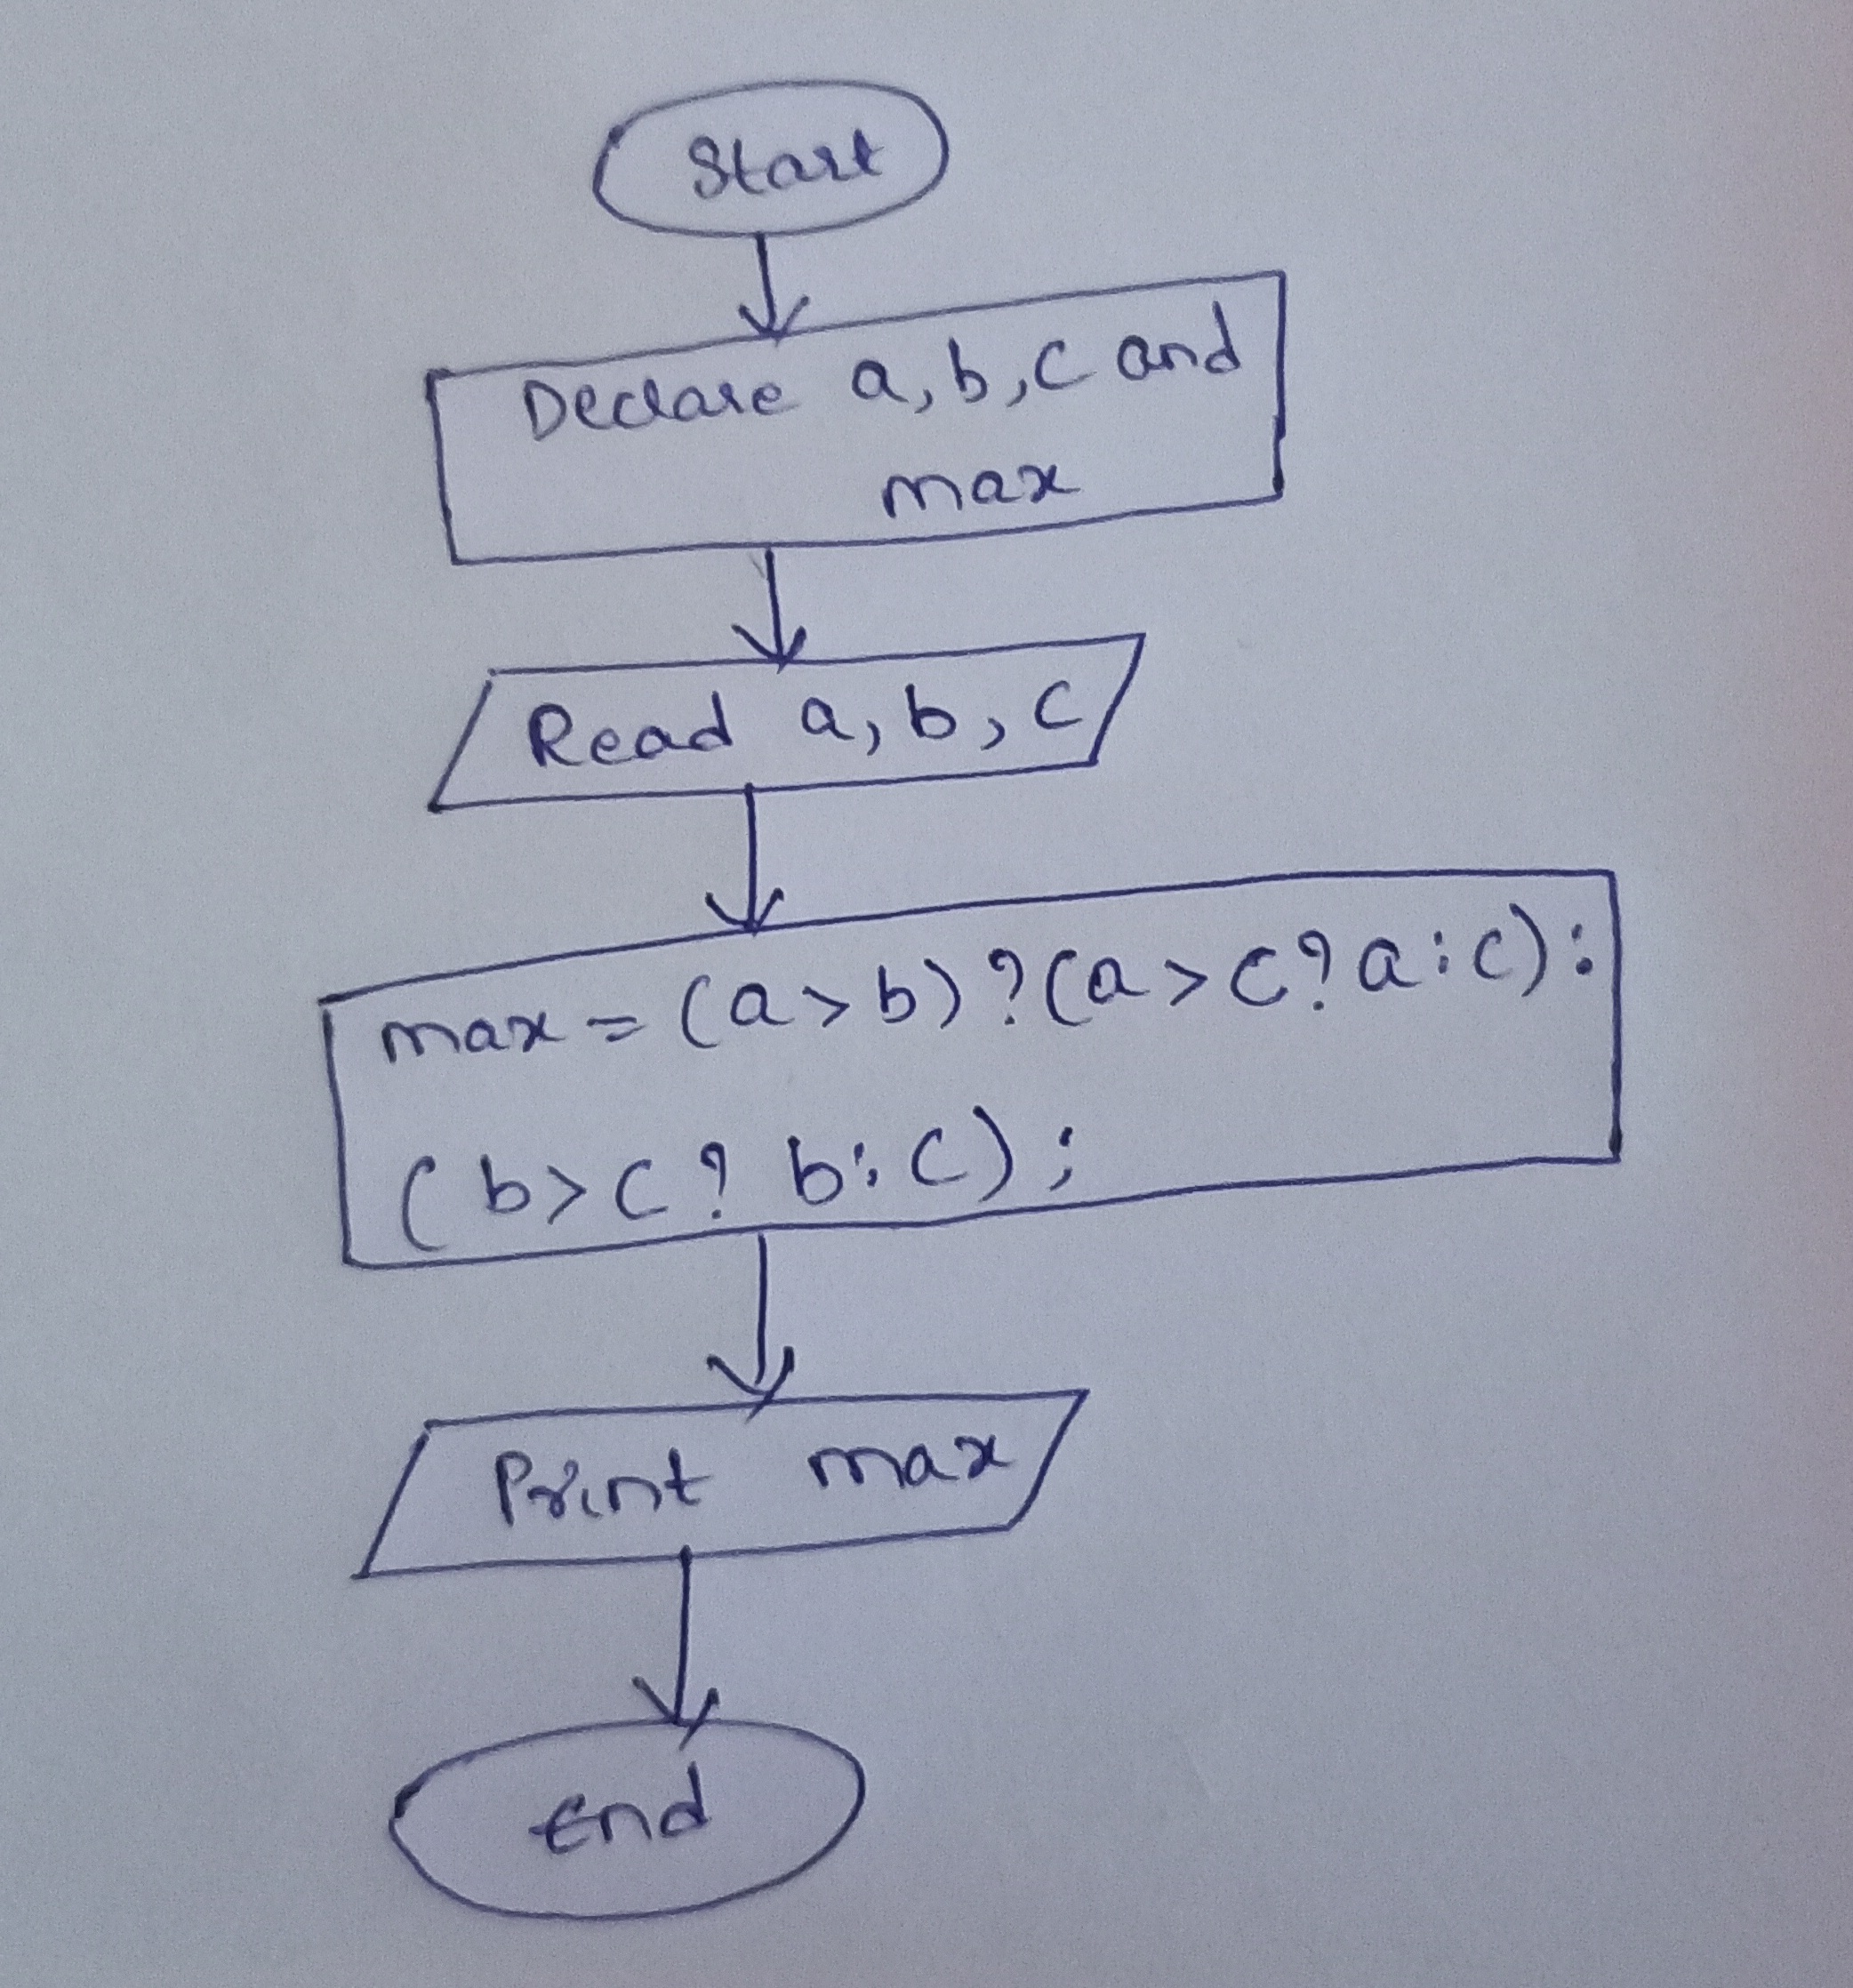
Flowchart to find the greatest of 3 numbers

Slide 2
Pseudocode to find the greatest of 3 numbers
Declare a variable a,b,c,max;
Read the number a,b,c
max = a > b ? (a > c ? a : c) : (b > c ? b : c);
print max;

